Slide 1

Address Translation
Pass
CS532: OS Foundations
Lab Assignment
Mail id: faiyaz@pdx.edu
Partner’s mail id: boyapati@pdx.edu

Slide 2
Instructions: Make a copy of this document, move your copy to your submissions folder and fill the document with your responses. Use the space on each slide to show your responses, and add additional slides as needed.
When ready for grading: complete the lab assignment submission form and include a link to your filled document

Slide 3
paging-linear-translate.py
Find the paging-linear-translate.py program within the vm-paging sub-directory of your ostep-homework directory. This program will help you practice doing address translations from virtual to physical addresses for a single-level page table Operating System.
Read the README.md file in the sub-directory and run the program with the --help switch to learn more about its functionality.

Slide 4
1. Use the simulator to study how linear page tables change size given different parameters. Compute the size of linear page tables as different parameters change. Some suggested inputs are below; by using the -v flag, you can see how many page-table entries are filled. First, to understand how linear page table size changes as the address space grows, run with these flags:
-P 1k -a 1m -p 512m -v -n 0
-P 1k -a 2m -p 512m -v -n 0
-P 1k -a 4m -p 512m -v -n 0

Slide 5
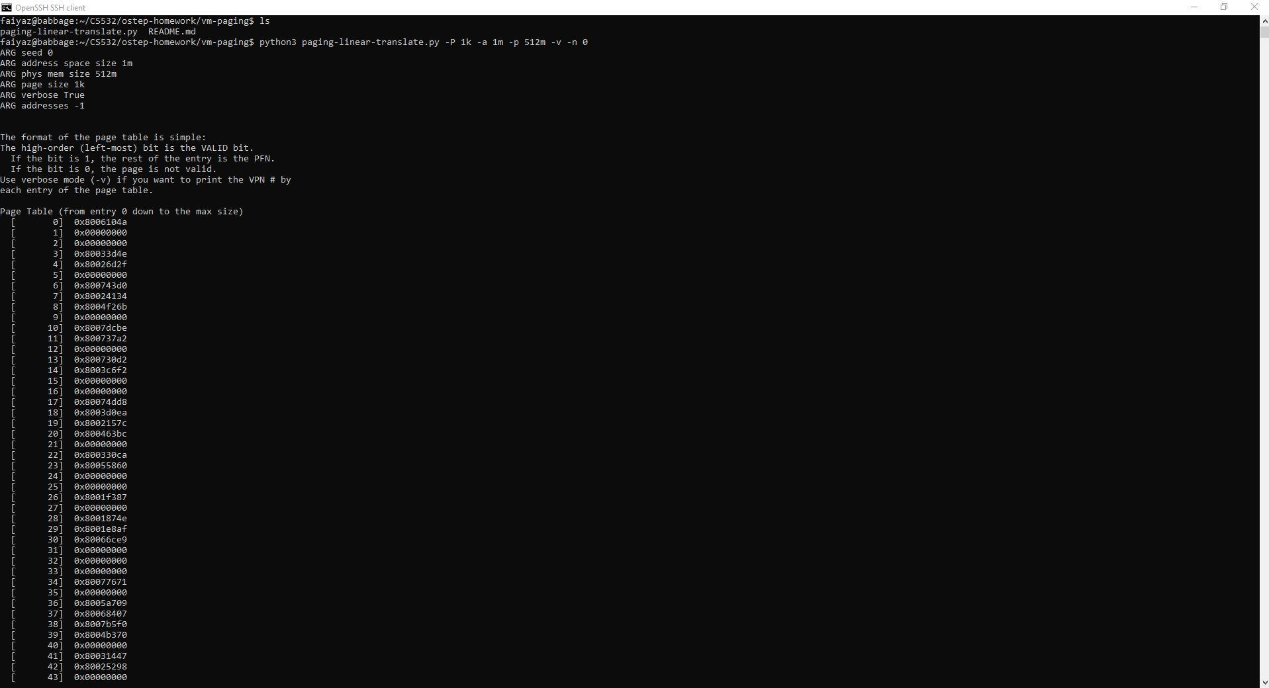
-P 1k -a 1m -p 512m -v -n 0

Slide 6
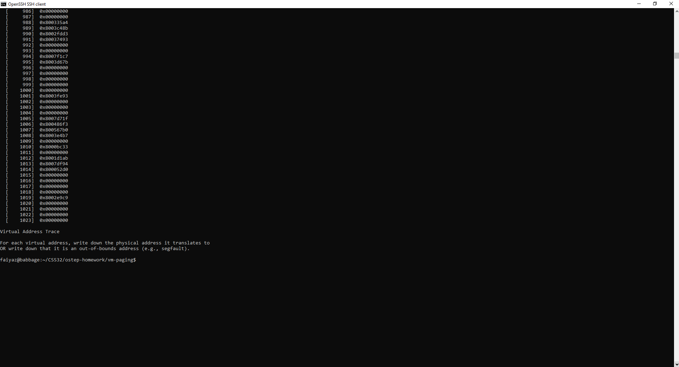

Slide 7
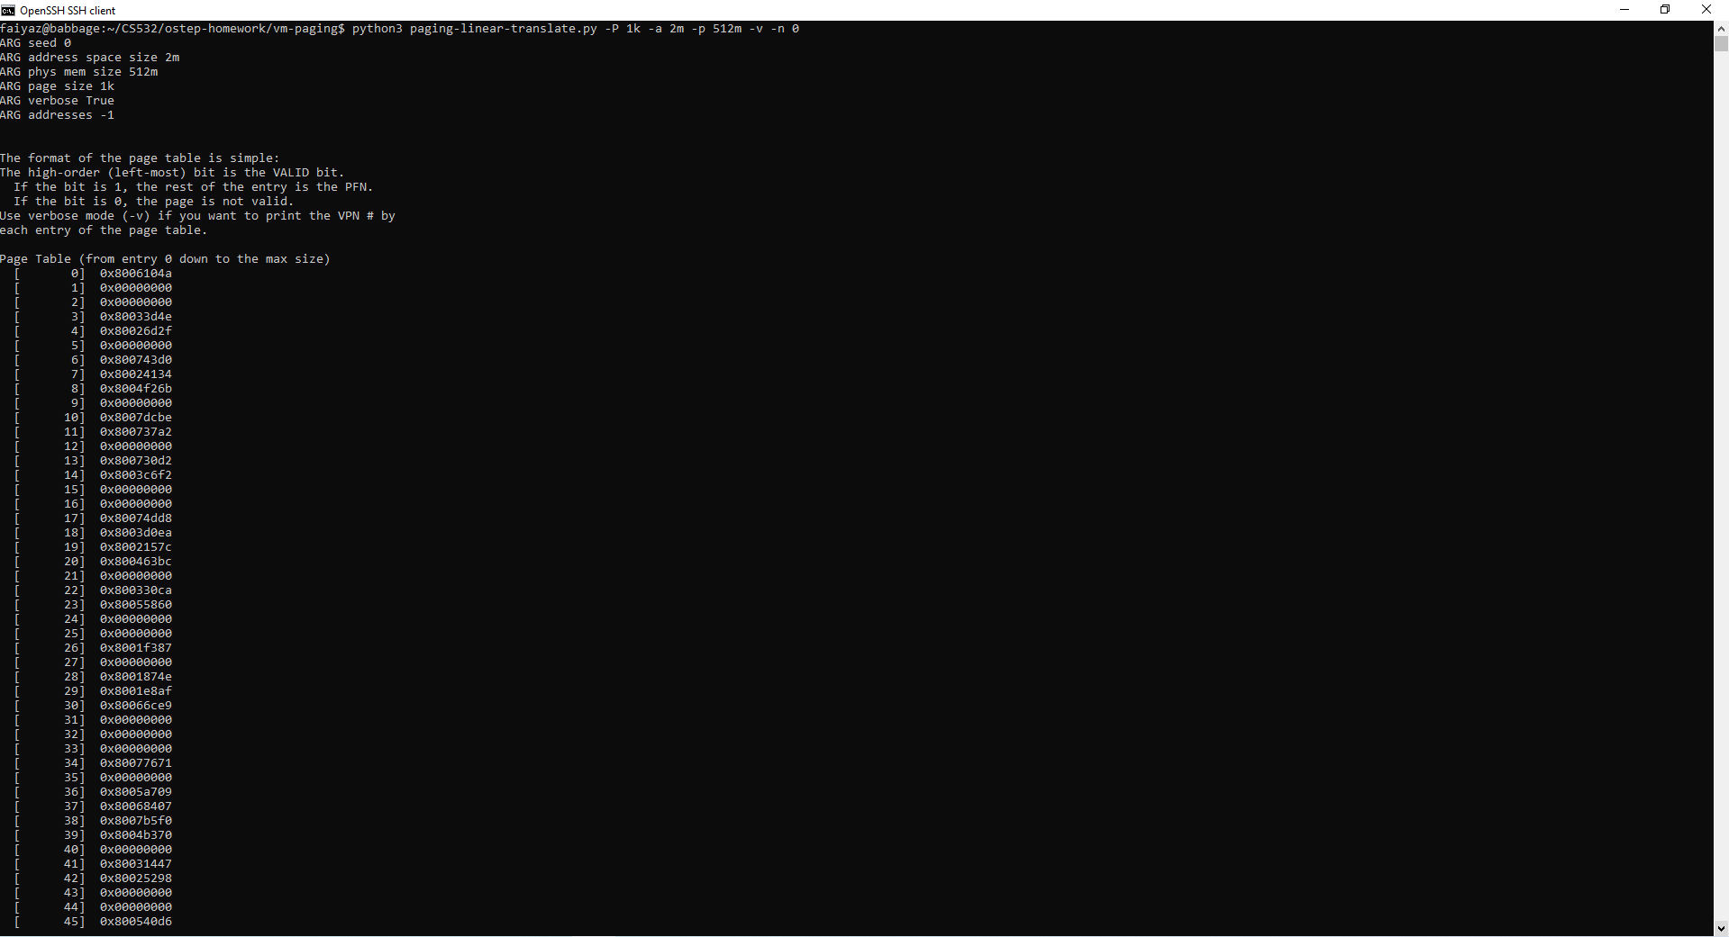
-P 1k -a 2m -p 512m -v -n 0

Slide 8
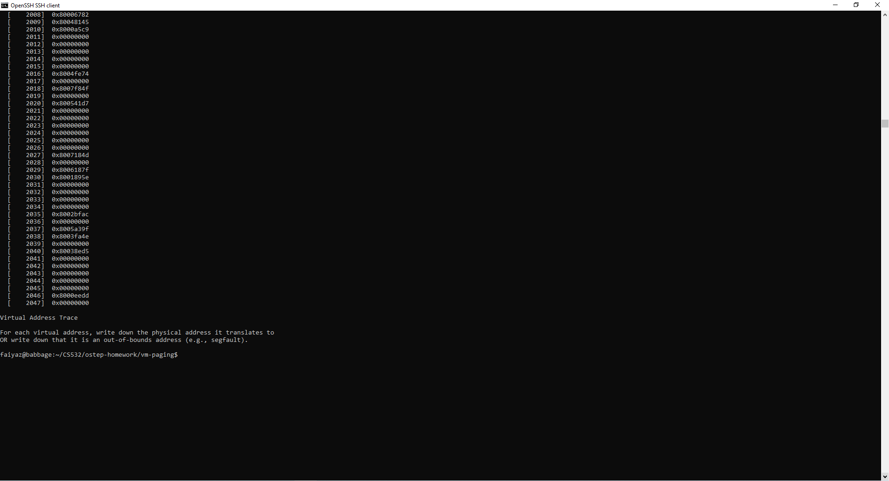

Slide 9

-P 1k -a 4m -p 512m -v -n 0

Slide 10
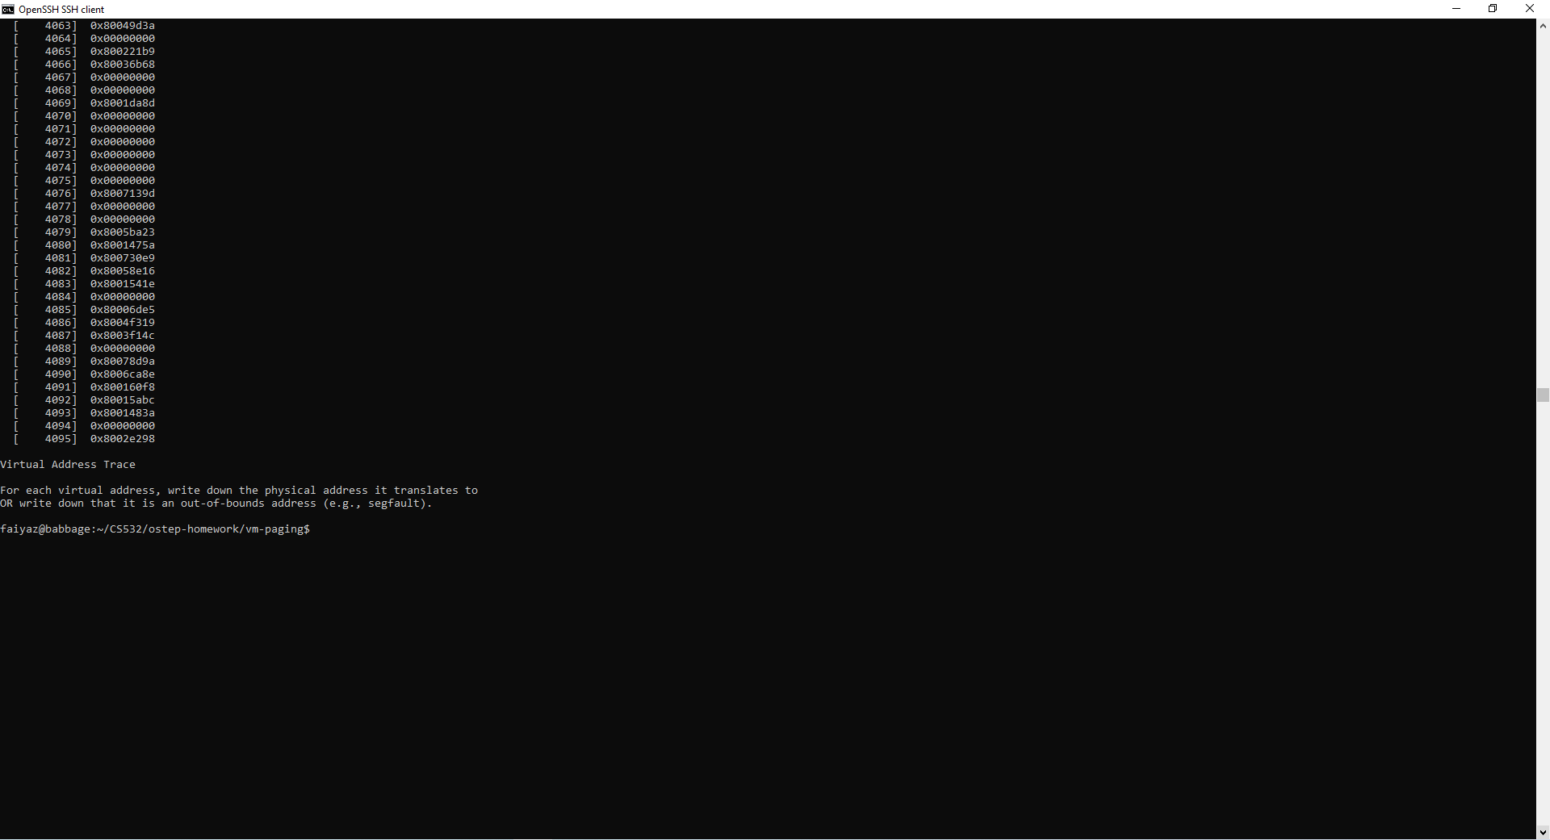

Slide 11
1. (cont)
Then, to understand how linear page table size changes as page size grows, run with each of these parameter settings:
-P 1k -a 1m -p 512m -v -n 0
-P 2k -a 1m -p 512m -v -n 0
-P 4k -a 1m -p 512m -v -n 0

Slide 12
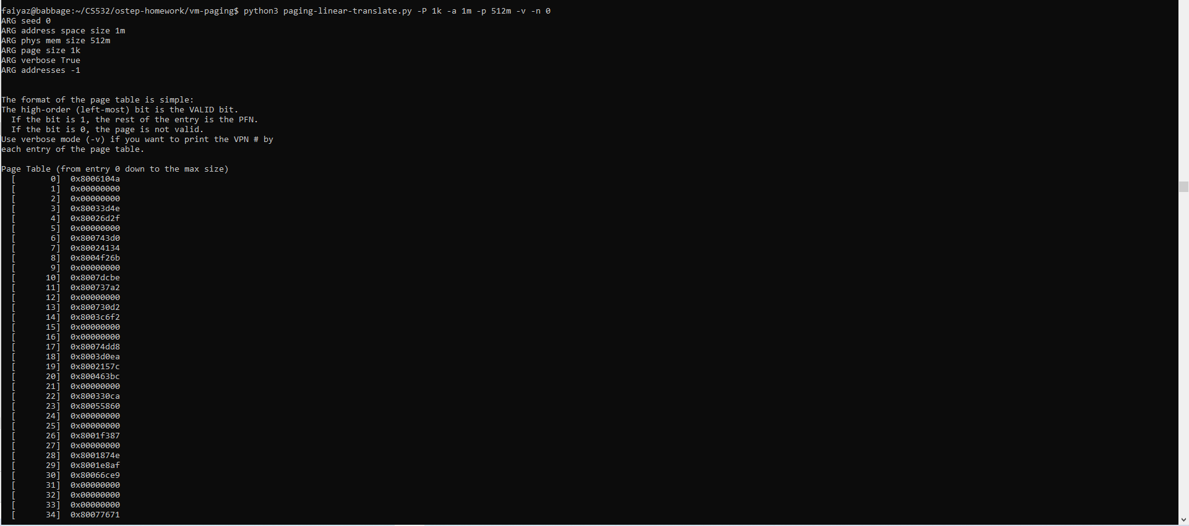
-P 1k -a 1m -p 512m -v -n 0

Slide 13
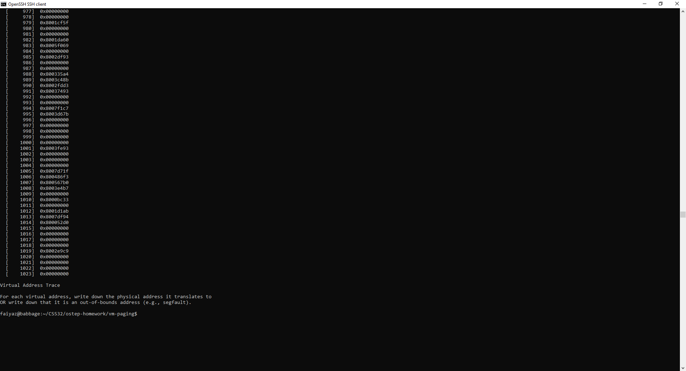

Slide 14

-P 2k -a 1m -p 512m -v -n 0

Slide 15
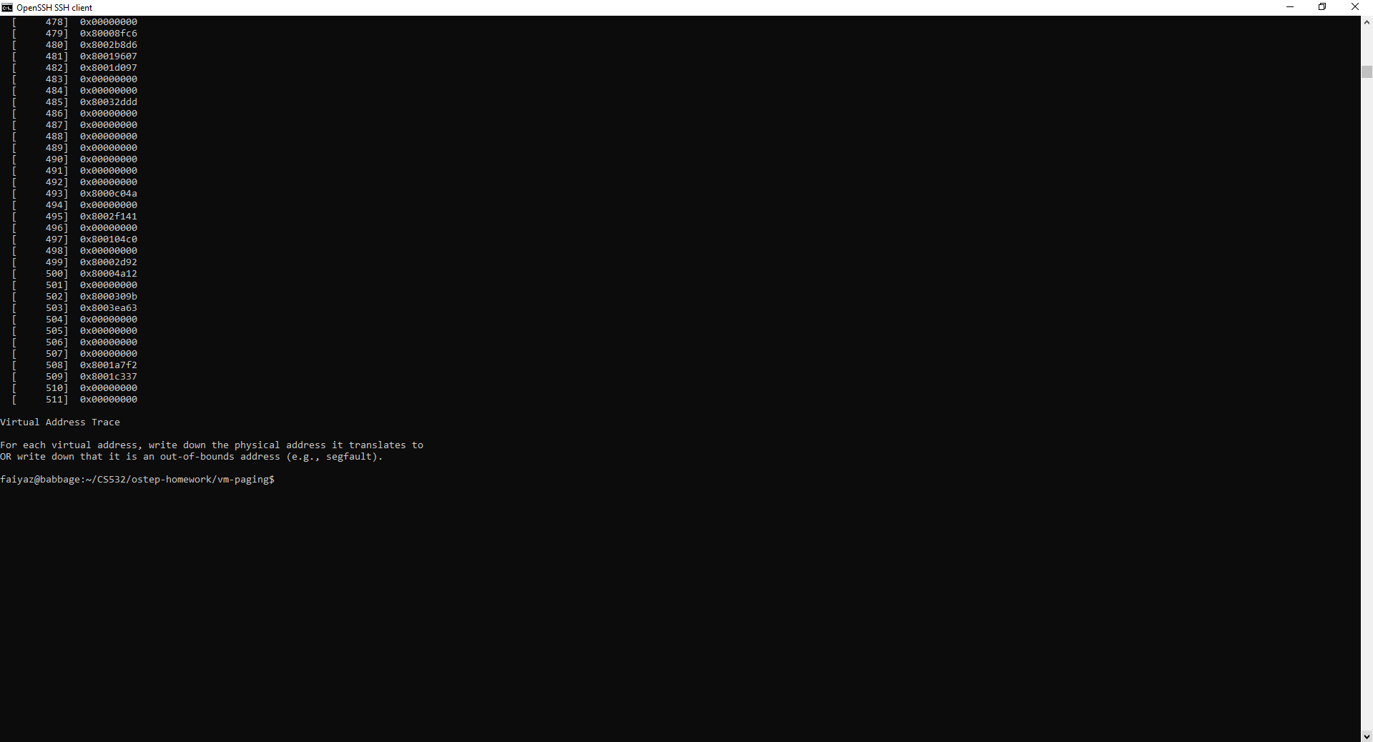

Slide 16

-P 4k -a 1m -p 512m -v -n 0

Slide 17
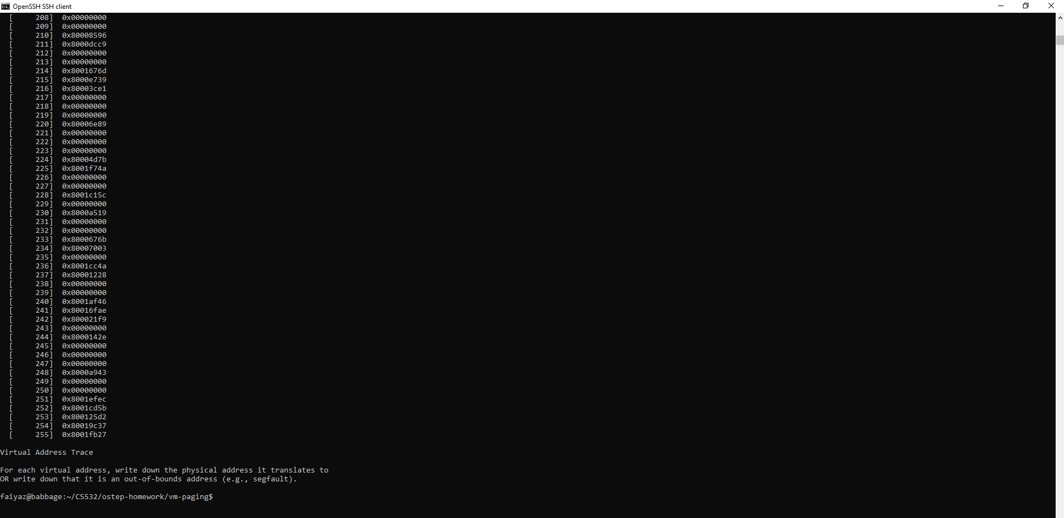

Slide 18
1. (cont)
A. How does page-table size change as the address space grows? Is it a linear relationship?
Answer: Yes, it is a linear relationship. As page table increases address space grows. This is because we need more pages to cover the whole address space.
B. How does page-table size change as the system page size grows? Is it a linear relationship?
Answer: No, it is not a linear relationship. It is a inverse relationship. As page size increases the page table size decreases. This is because we need less to cover the whole address space.

Slide 19
1. (cont)
C. It's nice that we can make the page table smaller by increasing the page size, but why not use big pages in general?
Answer: No, it is not nice to make the page table smaller by increasing the page size. Because bigger pages causes internal fragmentation which leads to the wasted memory space.

Slide 20
2. Now let’s do some translations. Start with some small examples, and change the number of pages that are allocated to the address space with the -u flag.
For example:
-P 1k -a 16k -p 32k -v -u 0
-P 1k -a 16k -p 32k -v -u 25
-P 1k -a 16k -p 32k -v -u 50
-P 1k -a 16k -p 32k -v -u 75
-P 1k -a 16k -p 32k -v -u 100

Slide 21
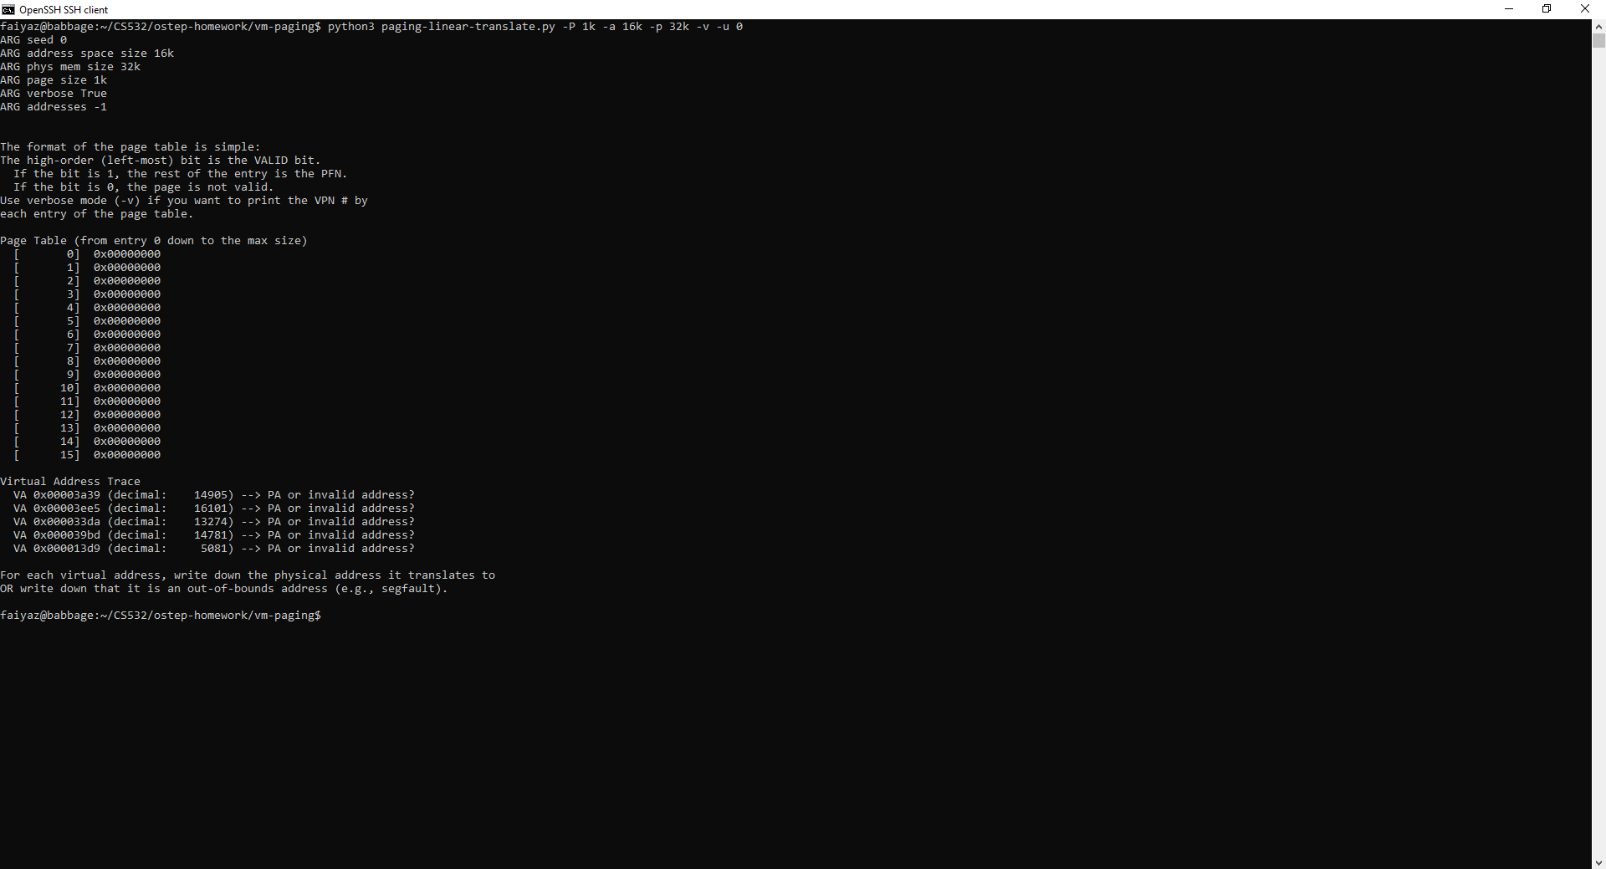
-P 1k -a 16k -p 32k -v -u 0

Slide 22
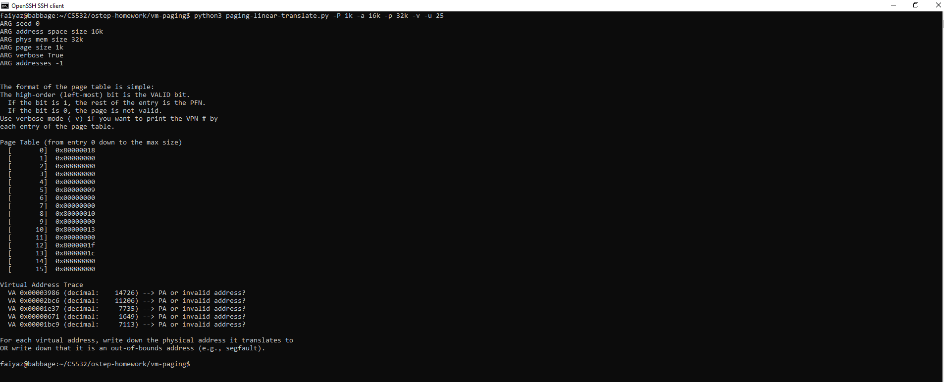
-P 1k -a 16k -p 32k -v -u 25

Slide 23
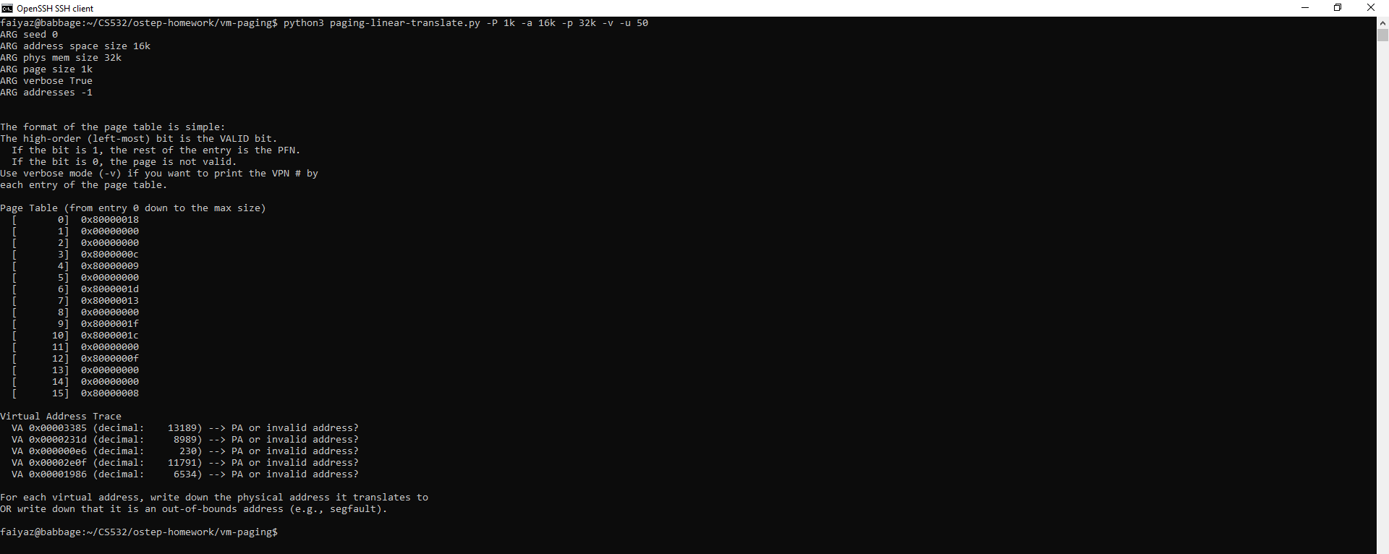
-P 1k -a 16k -p 32k -v -u 50

Slide 24
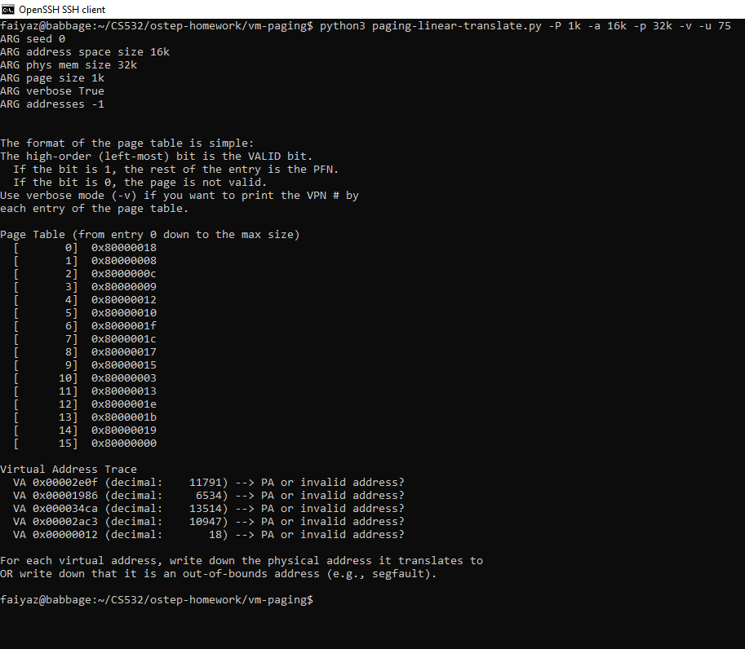
-P 1k -a 16k -p 32k -v -u 75

Slide 25
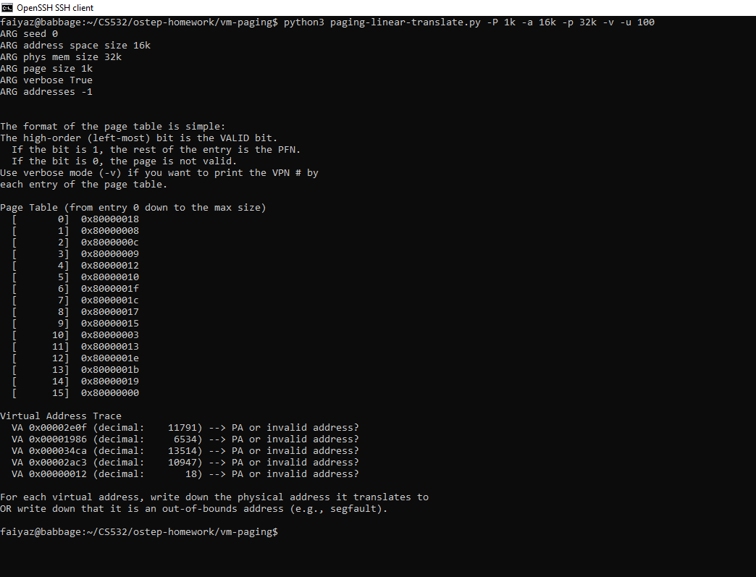
-P 1k -a 16k -p 32k -v -u 100

Slide 26
2. (cont)
What happens as you increase the percentage of pages that are allocated in each address space?
Answer: As the percentage of pages that are allocated in each address space is increased, more and more memory access operations become valid. This leads to decrease in free space and more valid pages.

Slide 27
3. Next, try some different random seeds, and some different (and sometimes quite crazy) address-space parameters, for variety:
-P 8 -a 32 -p 1024 -v -s 1
-P 8k -a 32k -p 1m -v -s 2
-P 1m -a 256m -p 512m -v -s 3
Which of these parameter combinations are unrealistic? Why?
– See slide 31 for answer.

Slide 28
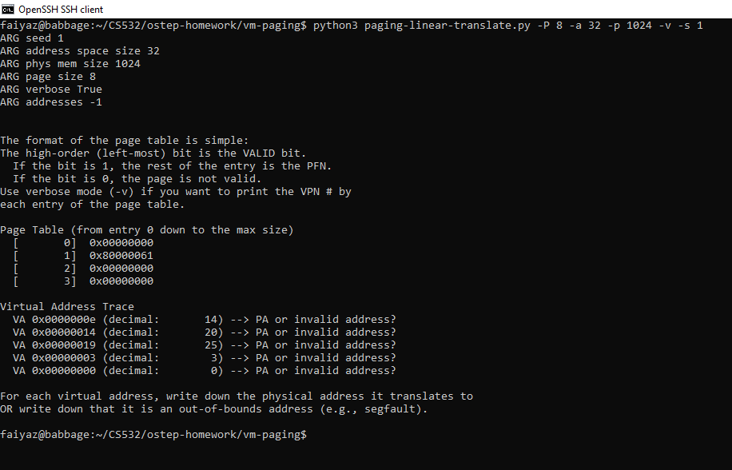
-P 8 -a 32 -p 1024 -v -s 1

Slide 29
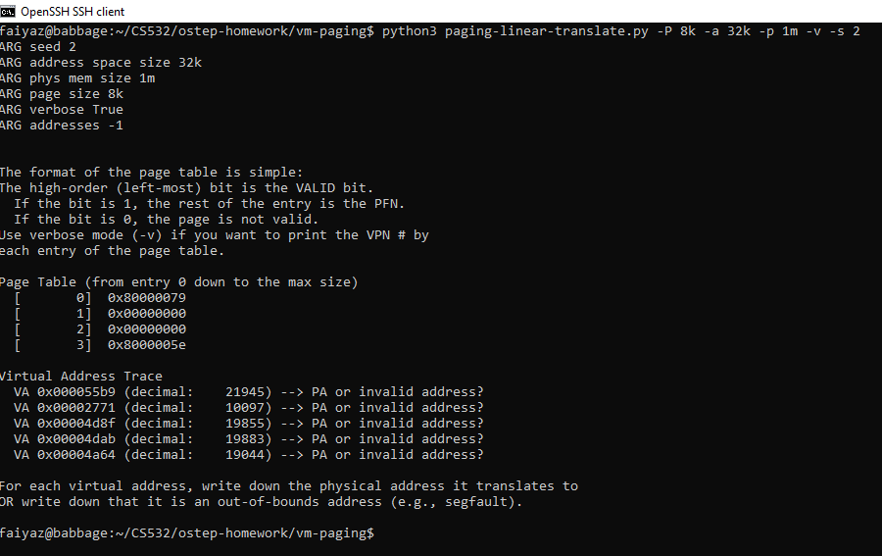
-P 8k -a 32k -p 1m -v -s 2

Slide 30
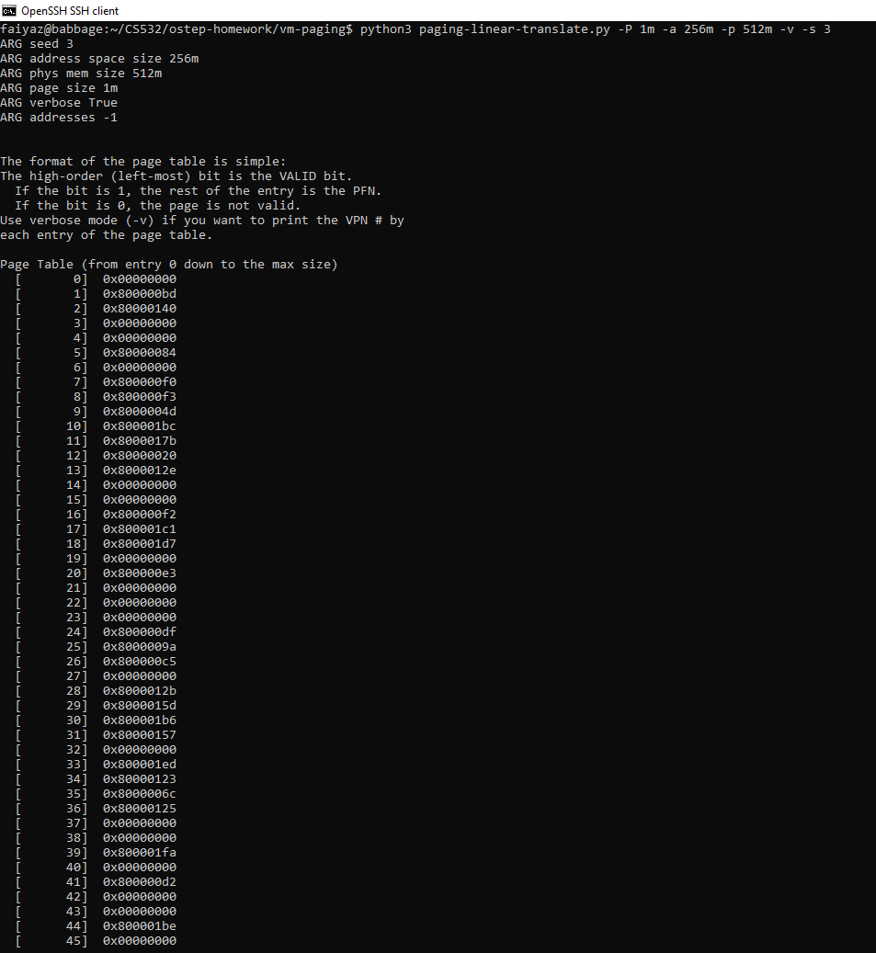
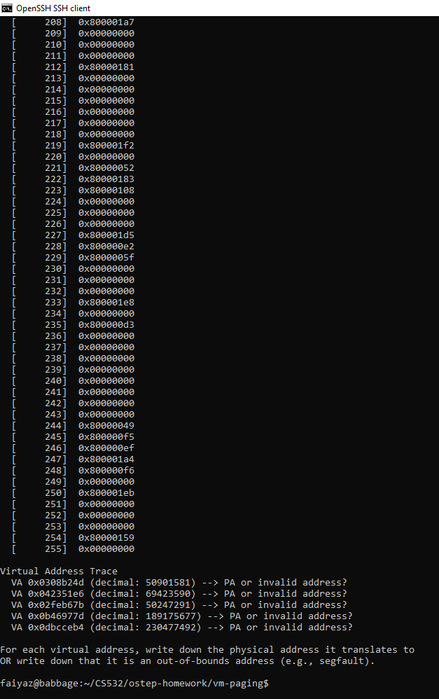
-P 1m -a 256m -p 512m -v -s 3

Slide 31
In my observation, the first one is unrealistic. It presents too small sizes of the parameters required to present a viable page table.

Slide 32
4. Use the program to try out some other problems of your own choice.
Can you find the limits of where the program doesn’t work anymore? For example, what happens if the address-space size is bigger than physical memory?
Answer:
The page size shouldn’t be greater than the address space.
The address space shouldn’t be greater than the the physical memory.
The page size can’t be zero. This leads to DivideByZero error.
The page size, physical memory and address space can’t be negative.

